Slide 1
CHAPTER 2
DOM
ACCESS
FUNCTIONS
PROPERTIES

Slide 2


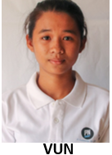




Who is the parent of Nhok ?
How many children does Vun have?
Who are the siblings of Kim ?

Slide 3

EXPLORE
GROUP OF 2
ACTIVITY 1
10 MIN
Answer questions on Word document
Notes:
They open the activity 2 and complete the word
ANSWERS
Q1 : elements are organized as containers (div contain p and buttons…)
Q2 : the identifiers can be the class (some items have the same class example : title) or the id (an id is unique)
They are used in CSS for the style, but they can also be used by javascript
Q3 : if you delete a container, everything that is contained by it is deleted too.
------------------------------------------
Show the html code in the dev tools, and ask what are all the class for.
-> they are used as reference so that css may use it, but also js !
-> build a parallel between css and js : placement in the Document, but also reference to objects.
-> end by describing the content of the page in order of DOM hierarchy
•Document
•header/body
• each header/body have their div, paragraphs
• each div contains paragraph or Images…

Slide 4
EXPLAIN
DOM
The DOM (Document Object Model) is a tree structure of an HTML page where each node is an object representing a part of this page
BODY
DIV
DIV
IMG
DEMO WITH CHROME
Notes:
Show the tree, explain notion of parent and childs
This is pretty cool :
https://codepen.io/pavlovsk/pen/QKGpQA

Slide 5
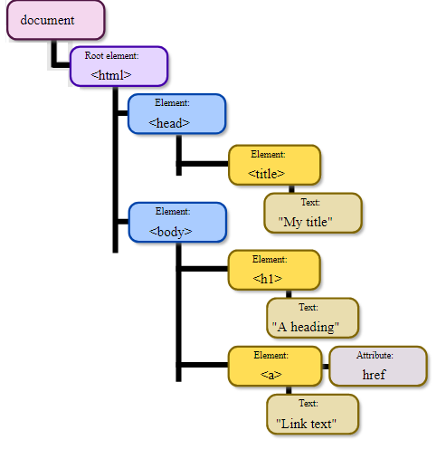
EXPLAIN
The document is the root element of the DOM tree
Elements can have
properties
Elements can have
children
Notes:
You can make a parallel with canvas to explain the root notion and the methods.
Document = the whole web page ⬄ Canvas = the drawing screen

Slide 6
EXPLORE
ACTIVITY 2
10 MIN
Answer questions on Word document
Notes:
They open the activity 2 and complete the word
IMPORTANT REMARK :
getElementById has no s, but getElementsByClassName and getElementsByTagName have an S to Elements ! Because they can return multiple elements, not like id.

Slide 7
EXPLAIN
Functions to access DOM elements
getElementById(<ID>) | Get the element that matches with id
getElementsByClassName(<Class Name>) | Get all elements that match with the class name
querySelectorAll(<QUERY>) | Get all child elements that match the query
Many other
Functions !
DEMO WITH CHROME
Notes:
!!!!!!!!!!!!!!!!!!!
If you really want to explain querySelectorAll, take the time to explain how queries are made (Using CSS tags etc…)

Slide 8
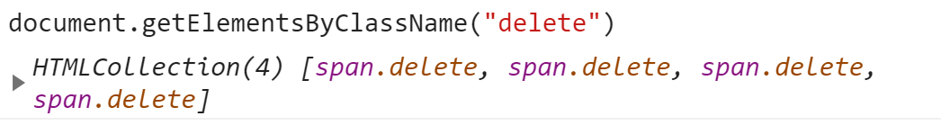
EXPLAIN
What is an HTML Collection ?
An HTML Collection is an array of DOM elements
Let’s
See how to do!
GET SIZE
ACCESS BY INDEX
ACCESS BY ID
Notes:
Show them you can access to the size and each element the SAME way as a ARRAY
myCollection.length // size of the collectin
myCollection[i] // access to the elmeent at index i
myCollection["myForm"] // access to the elmeent of id "myForm"

Slide 9
EXPLORE
ACTIVITY 3
30 MIN
Answer questions on Word document

Slide 10
EXPLAIN
Let’s change some DOM properties!
textContent | Get / Set the text of an element
className | Get / Set the class of an element GUESS : How do set multiple classes ?
style.display | show or hide an element Ex: None (hide), block (visible)
DEMO WITH CHROME

Slide 11

Now you should know this:
1- What is the DOM Tree
- The document root element
- DOM element properties / function
2- Functions to access to DOM elements
getElementById
getElementsByClassName
querySelector
3- What is an HTML Collection ?
myCollection.length // size of the collection
myCollection[i] // access to the element at index i
myCollection["myForm"] // access to the element of id "myForm"
4- Change some DOM element properties
textContent
className
style.display (none, block ...)
style.<property> ex : color...

